Slide 1
“Computer Network Lab-2015 Course” Network Simulator-2

Slide 2
NS2 Outline
What is it?
How do I get it?
How do I use it?
<number>
Notes:
<number>
We are going to now look at a particular simulator – the NS2 simulator
Its open source – available at source forge

Slide 3
What is NS2?
ns-2 stands for Network Simulator version 2.
ns-2: is a discrete event simulator for networking research
Work at packet level.
Provide substantial support to simulate bunch of protocols like TCP, UDP, FTP, HTTP and DSR.
Simulate wired and wireless network.
Is primarily Unix based.
<number>
Notes:
<number>
Read

Slide 4
What is NS2? (contd…)
Use TCL as its scripting language.
ns-2 is a standard experiment environment in research community.
otcl: Object-oriented support
tclcl: C++ and otcl linkage
<number>

Slide 5
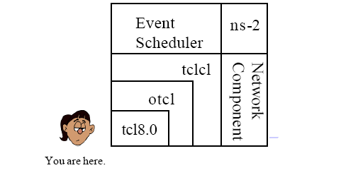
What is NS2? (contd…)
<number>

Slide 6
NS Status
ns-2
100K lines of C++
70K lines of OTcl
50K+ lines of test suite, examples, docs
Platforms
Most UNIX and UNIX-like systems (FreeBSD, Linux, Sun Solaris)
Window 95/98/NT with Cygwin
(Emulation only for FreeBSD for now)
<number>
<number>
Notes:
<number>

Slide 7
Why two language? (Tcl & C++)
C++: Detailed protocol simulations require systems programming language (byte manipulation, packet processing, algorithm implementation)
– Run time speed is important
– Turn around time (run simulation, find bug, fix bug,recompile, re-run) is slower
Tcl: Simulation of slightly varying parameters or configurations
– quickly exploring a number of scenarios
– iteration time (change the model and re -run) is more
important
<number>

Slide 8
Otcl and C++: The Duality
C++
C++/OTcl
split objects
otcl
OTcl (object variant of Tcl) and C++ share class hierarchy
TclCL is glue library that makes it easy to share functions, variables, etc
<number>

Slide 9
ns-2 Directory Structure
sim
tcl8.0
tk8.0
otcl
Tcl
ns-2
nam-1
tcl code
C++ code
tcl
...
example
ex
test
lib
...
validation test
tcl code core
<number>

Slide 10
Class Hierarchy (Partial)
TclObject
NsObject
Connector
Classifier
Queue
Delay
Agent
Trace
AddrClassifier
McastClasifier
DropTail
RED
TCP
Enq
Dnq
Drop
Reno
SACK
<number>

Slide 11
NS2 Outline
What is it?
How do I get it?
How do I use it?
Documentation
<number>
Notes:
<number>
We are going to now look at a particular simulator – the NS2 simulator
Its open source – available at source forge

Slide 12
How Do I get NS2?
Get ns-2.29 all-in-one package from ns site. Get MannaSim Framework ns-2.29 patch.
http://www.mannasim.dcc.ufmg.br/download.htm
Type the following command on the ns-allinone-2.29 folder:
patch -p1 < file_name.diff
Install ns-2.29 as usual typing ns-allinone-2.29 folder:
./install
<number>
Notes:
<number>
Read
Installing NS2 is non-trivial on the cs machines because of various dependencies, so its been already done for us.

Slide 13
NS2 Outline
What is it?
How do I get it?
How do I use it?
Documentation
<number>
Notes:
<number>
We are going to now look at a particular simulator – the NS2 simulator
Its open source – available at source forge

Slide 14
How Do I use it?
Creating a Simple Topology
Getting Traces
Using NAM
<number>
Notes:
<number>
We’ll look at how to create topologies, how to get the traces and then how to use NAM to visualise our network

Slide 15
A simple Example – Creating the topology
ftp
TCP
n5
sink
n0
n4
n2
n3
n1
n6
UDP
n7
null
<number>
CBR
Notes:
<number>
NS2 lets us create topologies with different nodes, different types of links in betweeb them

Slide 16
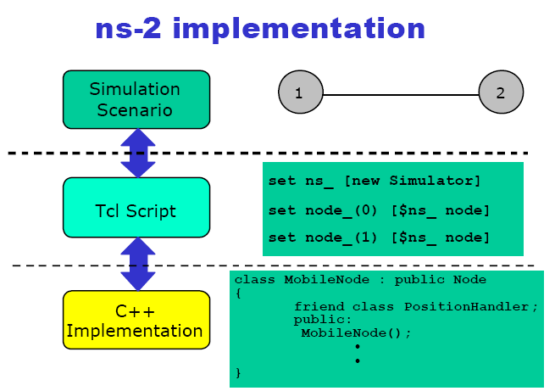
<number>

Slide 17
Creating the topology
#create a new simulator object
set ns [new Simulator]
generates an NS simulator object instance, and assigns it to variable ns.
What this line does is the following:
Initialize the packet format
Create a scheduler
Select the default address format
The "Simulator" object has member functions that do the following:
Create compound objects such as nodes and links
Connect network component objects created (ex. attach-agent)
Set network component parameters
Create connections between agents (ex. make connection between a "tcp" and "sink")
Specify NAM display options Etc.
<number>
Notes:
<number>
set ns [new Simulator]: generates an NS simulator object instance, and assigns it to variable ns (italics is used for variables and values in this section). What this line does is the following:
Create a scheduler (default is calendar scheduler)
The "Simulator" object has member functions that do the following:
Create compound objects such as nodes and links (described later)
Connect network component objects created (ex. attach-agent)
Set network component parameters (mostly for compound objects)
Create connections between agents (ex. make connection between a "tcp" and "sink")

Slide 18
Creating the topology
#open the nam trace file
set nf [open out.nam w]
$ns namtrace-all $nf
#define a 'finish' procedure
proc finish {} {
global ns nf
$ns flush-trace
#close the trace file
close $nf
#execute nam on the trace file
exec nam out.nam &
exit 0}
<number>
Notes:
<number>
set ns [new Simulator]: generates an NS simulator object instance, and assigns it to variable ns (italics is used for variables and values in this section). What this line does is the following:
Create a scheduler (default is calendar scheduler)
The "Simulator" object has member functions that do the following:
Create compound objects such as nodes and links (described later)
Connect network component objects created (ex. attach-agent)
Set network component parameters (mostly for compound objects)
Create connections between agents (ex. make connection between a "tcp" and "sink")

Slide 19
Creating the topology (Contd)
#create nodes
set n0 [$ns node]
set n1 [$ns node]
set n2 [$ns node]
set n3 [$ns node]
set n4 [$ns node]
set n5 [$ns node]
set n6 [$ns node]
set n7 [$ns node]
#create a duplex link between the nodes
$ns duplex-link $n0 $n2 1Mb 10ms DropTail
<number>
Notes:
<number>
set n0 [$ns node]: The member function node creates a node. A node in NS is compound object made of address and port classifiers (described in a later section). Users can create a node by separately creating an address and a port classifier objects and connecting them together. However, this member function of Simulator object makes the job easier.
$ns duplex-link node1 node2 bandwidth delay queue-type: creates two simplex links of specified bandwidth and delay, and connects the two specified nodes. In NS, the output queue of a node is implemented as a part of a link, therefore users should specify the queue-type when creating links. In the above simulation script, DropTail queue is used. If the reader wants to use a RED queue, simply replace the word DropTail with RED.

Slide 20
Creating the topology (Contd)
#create a duplex link between the nodes
$ns duplex-link $n0 $n2 1Mb 10ms DropTail
$ns duplex-link $n1 $n2 1Mb 10ms DropTail
$ns duplex-link $n2 $n3 1Mb 10ms DropTail
$ns duplex-link $n3 $n4 1Mb 10ms DropTail
$ns duplex-link $n4 $n5 1Mb 10ms DropTail
$ns duplex-link $n3 $n6 1Mb 10ms DropTail
$ns duplex-link $n6 $n7 1Mb 10ms DropTail
#setting up the queue limit between the nodes
$ns queue-limit node2 node3 10
<number>
Notes:
<number>
set n0 [$ns node]: The member function node creates a node. A node in NS is compound object made of address and port classifiers (described in a later section). Users can create a node by separately creating an address and a port classifier objects and connecting them together. However, this member function of Simulator object makes the job easier.
$ns duplex-link node1 node2 bandwidth delay queue-type: creates two simplex links of specified bandwidth and delay, and connects the two specified nodes. In NS, the output queue of a node is implemented as a part of a link, therefore users should specify the queue-type when creating links. In the above simulation script, DropTail queue is used. If the reader wants to use a RED queue, simply replace the word DropTail with RED.

Slide 21
Creating the topology (Contd)
#create a duplex link between the nodes
$ns duplex-link-op $n0 $n2 orient right-down
$ns duplex-link-op $n1 $n2 orient right-up
$ns duplex-link-op $n2 $n3 orient right
$ns duplex-link-op $n3 $n4 orient right-up
$ns duplex-link-op $n4 $n5 orient right-up
$ns duplex-link-op $n3 $n6 orient right-down
$ns duplex-link-op $n6 $n7 orient right-down
<number>
Notes:
<number>
set n0 [$ns node]: The member function node creates a node. A node in NS is compound object made of address and port classifiers (described in a later section). Users can create a node by separately creating an address and a port classifier objects and connecting them together. However, this member function of Simulator object makes the job easier.
$ns duplex-link node1 node2 bandwidth delay queue-type: creates two simplex links of specified bandwidth and delay, and connects the two specified nodes. In NS, the output queue of a node is implemented as a part of a link, therefore users should specify the queue-type when creating links. In the above simulation script, DropTail queue is used. If the reader wants to use a RED queue, simply replace the word DropTail with RED.

Slide 22
Creating the topology (Contd)
#Setup a TCP connection
set tcp [new Agent/TCP]
$tcp set class_ 2
$ns attach-agent $n0 $tcp
set sink [new Agent/TCPSink]
$ns attach-agent $n5 $sink
$ns connect $tcp $sink
$tcp set fid_ 1
#Setup a FTP over TCP connection
set ftp [new Application/FTP]
$ftp attach-agent $tcp
$ftp set type_ FTP
<number>

Slide 23
Creating the topology (Contd)
#Setup a UDP connection
set udp [new Agent/UDP]
$ns attach-agent $n1 $udp
set null [new Agent/Null]
$ns attach-agent $n7 $null
$ns connect $udp $null
$udp set fid_ 2
#Setup a CBR over UDP connection
set cbr [new Application/Traffic/CBR]
$cbr attach-agent $udp
$cbr set type_ CBR
$cbr set packet_size_ 1000
$cbr set rate_ 1mb
$cbr set random_ false
<number>

Slide 24
Creating the topology (Contd)
#Schedule events for the CBR and FTP agents
$ns at 0.1 "$cbr start"
$ns at 1.0 "$ftp start"
$ns at 4.0 "$ftp stop"
$ns at 4.5 "$cbr stop"
#Detach tcp and sink agents (not really necessary)
$ns at 4.5 "$ns detach-agent $n0 $tcp ; $ns detach-agent $n3 $sink"
#Call the finish procedure after 5 seconds of simulation time
$ns at 5.0 "finish"
#Print CBR packet size and interval
puts "CBR packet size = [$cbr set packet_size_]"
puts "CBR interval = [$cbr set interval_]"
#Run the simulation
$ns run
<number>

Slide 25
To run a tcl script using NS2
To run,
$ ns simple.tcl
Internally, NS2 instantiates C++ classes based on the tcl scripts
Output is in form of trace files or NAM file or both
<number>
Notes:
<number>
Read

Slide 26
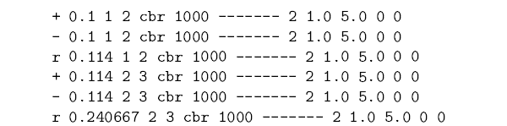
Observing Network Behavior
Observe behavior by tracing “events”
Eg. packet received, packet drop etc.
Src Dst IP Address, Port
time
<number>
Notes:
<number>
The picture shows an example trace file:
- + shows that a packet entered the queue
- shows that a packet left the queue
- r shows the packet was received
time, type of packet etc

Slide 27
Observing Network Behavior
NAM:
Network Animator
A visual aid showing how packets flow along the network
We’ll see a demo..
<number>
Notes:
<number>
Apart from having a trace file, it comes with a Network animator tool that allows visualization of nodes (much like the diagrams that we see in text books)

Slide 28
Outline
What is it?
How do I get it?
How do I use it?
Documentation
<number>

Slide 29
Documentation – NS2 Documentation
NS2 Manual
Information about Otcl interpreter, C++ class hierarchy, parameters for various protocols
http://www.isi.edu/nsnam/ns/doc/index.html
Very detailed, useful when looking for something specific, like:
What are the shadowing models available for wireless? How do I select them?
How do I make my routing strategy to be Distance Vector routing?
<number>

Slide 30
Documentation – NS2 documentation
NS2 Tutorial by Marc Greis
http://www.isi.edu/nsnam/ns/tutorial/index.html
Good starting point for understanding the overall structure of NS2
Examples:
What is the relation between c++ classes and Otcl classes?
basic info on instantiating NS2 instance, tcl scripting
<number>

Slide 31
Documentation – NS2 Documentation
NS2 for beginners
http://www-sop.inria.fr/maestro/personnel/Eitan.Altman/COURS-NS/n3.pdf
More detailed than Marc Greis’ Tutorial
More info on getting it up and running – rather than internals
Examples:
What does each line of a tcl script do?
Most common examples of trace formats that are useful
<number>

Slide 32
Documentation – Tcl Documentation
Tcl Tutorial
http://www.tcl.tk/man/tcl8.5/tutorial/tcltutorial.html
Tcl Manual
All commands and their explanation
http://www.tcl.tk/man/tcl8.6/TclCmd/contents.htm
<number>

Slide 33

<number>

